Slide 1



Web Accessibility and Site Governance in Drupal
By John Lockhart

Slide 2
John Lockhart
School Web Development Officer at the Edinburgh Law School

Slide 3
Hidde de Vries
This talk is inspired by, and largely based on the following talk by Hidde
Your CMS is an accessibility assistant (search Google/YouTube)
https://talks.hiddedevries.nl/tGzZs2/your-cms-is-an-accessibility-assistant
Definitely watch the video recording of his talk, much more detail can be found there
https://youtu.be/cXBAST0GZuM?si=gzXxlm1RdsTOaXob

Slide 4
Hidde de Vries
Hidde de Vries is a front-end, accessibility and design systems specialist. He has previously worked for organisations including the Dutch government, W3C (WAI), Sanity.io and Mozilla.
Do check out Hidde’s blog:
https://hidde.blog

Slide 5
Accessibility is hard

Slide 6
Why Isn't Accessibility easier?

Slide 7
Built-in accessibility

Slide 8
Can’t we just build accessibility into our products?

Slide 9
(Don’t use) Overlays
Don’t use overlays
Basically:
1. Overlays are third-party software that make accessibility “improvements” to your website.
2. To genuinely resolve accessibility issues, you need to have near total control of your website in order to address the source of the original error.
3. Also, according to many users with disabilities, they just don’t work. (See the “In their own words” section of the Overlay Fact Sheet website for testimonies).

Slide 10
Overlay Fact Sheet
Read the Overlay Fact Sheet for more information:
https://overlayfactsheet.com

Slide 11
Design Systems
Design systems are an excellent way to build in accessibility to some of your work.
If you are able to take your design and split it up into reusable components, then you can make your accessibility, or at least some of it, reusable and repeatable.
If you have accessible (well tested) components, you can make accessibility reusable and repeatable.
https://design-system.ed.ac.uk

Slide 12
Design Systems
Example: a Card component.
You can document in your design system ways of saying hey, this is how you are supposed to use this component.
You can explain how users use the web and why that helps.

Slide 13
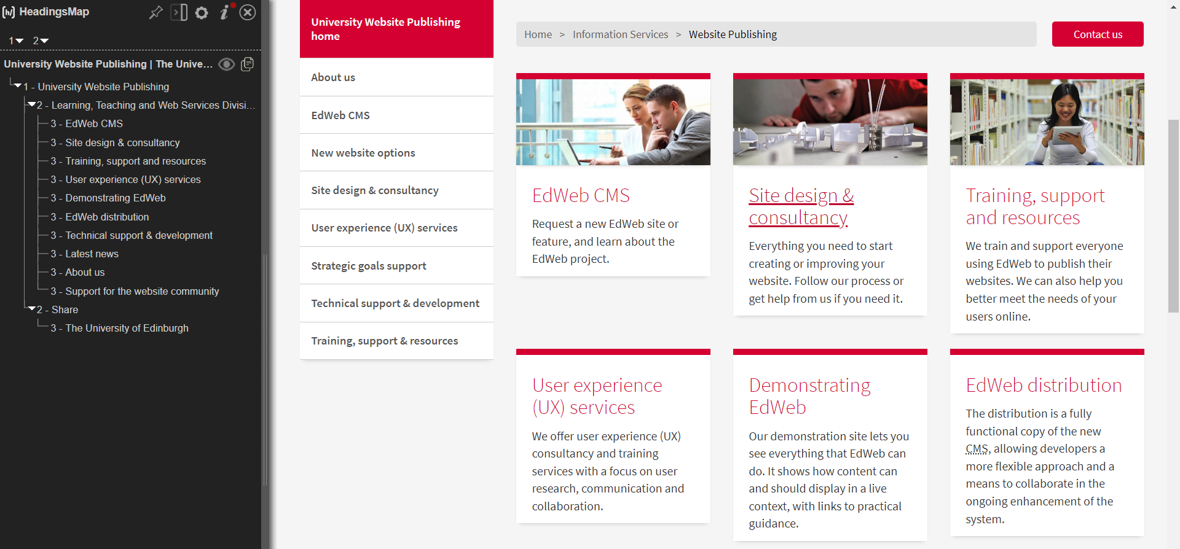

Slide 14
Browsers
Browsers can fix a small subset of accessibility issues in the content for end users.
Not a get out of jail card, but could be very helpful.

Slide 15
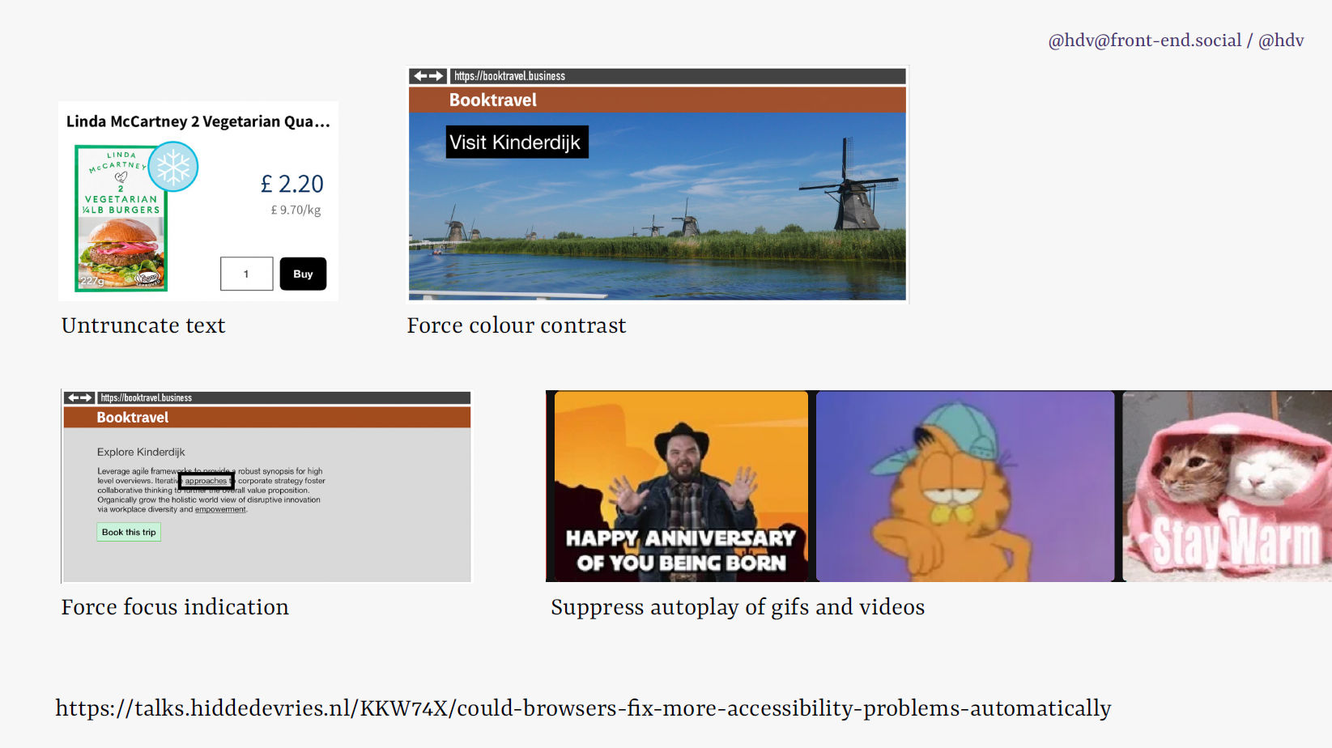

Slide 16
HTML
Problems can be fixed in HTML.
Browsers or HTML have features that provides for accessibility.
Example: the image tag. It allows you to provide alternative text for an image.
Example: the video tag, with captions. Just supply the caption information and the browser will make sure the right caption shows at the right time.
Emphasise the importance of using semantic HTML.

Slide 17
CMSs can help with accessibility
A good CMS can help with accessibility in the authoring process

Slide 18
Assessing CMS accessibility in two ways

Slide 19
WCAG
The W3C Web Content Accessibility Guidelines are designed to make Web content more accessible.
The Public Sector Body Accessibility Regulations (PSBAR) are essentially based on meeting the W3C WCAG 2.2 AA Guidelines.
There are similar regulations for other jurisdictions (USA, EU, others)

Slide 20
ATAG
The W3C Authoring Tool Accessibility Guidelines (ATAG) explains how to:
A. Make the authoring tools themselves accessible, so that people with disabilities can create web content, and
B. Help authors create more accessible web content — specifically: enable, support, and promote the production of content that conforms to Web Content Accessibility Guidelines (WCAG).
https://www.w3.org/WAI/standards-guidelines/atag/

Slide 21
Examples of ATAG (Part B)
B.1.1.2
When content is auto-generated, there is a prompt for required accessibility information
Examples: caption for a table, alt text for images in a carousel, labels for form fields
B.2.1.1
Ensure that accessible content production is possible
Example: for each image field, there is an alt text field
Example: for each video player field, there is a captions upload button

Slide 22
W3C Authoring Tools List
Tools listing has information on how the tool meets the web standard: Authoring Tool Accessibility Guidelines (ATAG).
At this time of writing, five authoring tools are listed on their webpage.
One of these is Drupal (Core).
https://www.w3.org/WAI/tools-list/authoring/

Slide 23
“Support the production of accessible content”

Slide 24
CMSs as accessibility assistants

Slide 25
Example: A Card Component

Slide 26
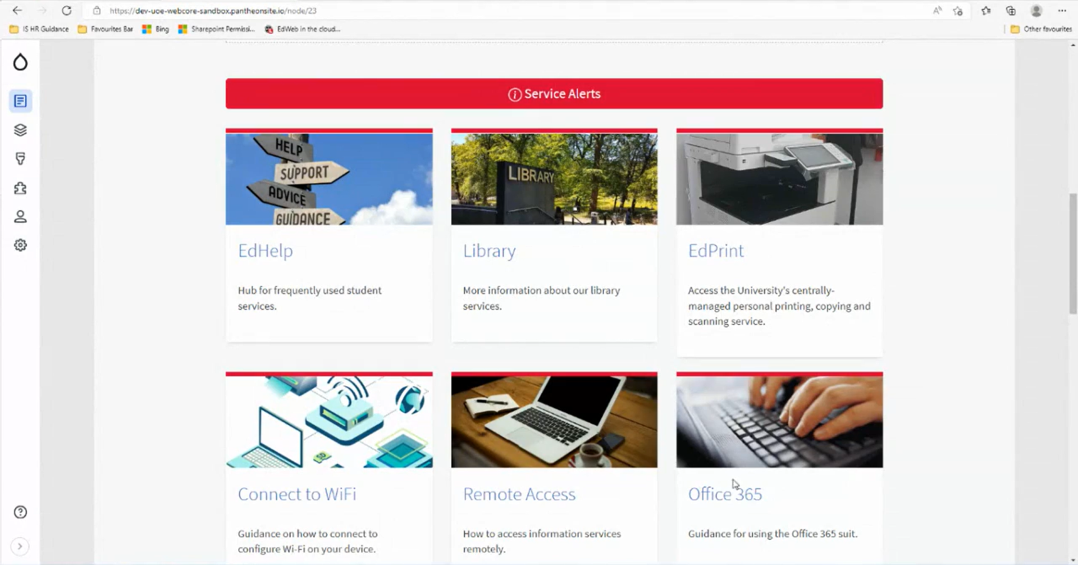

Slide 27
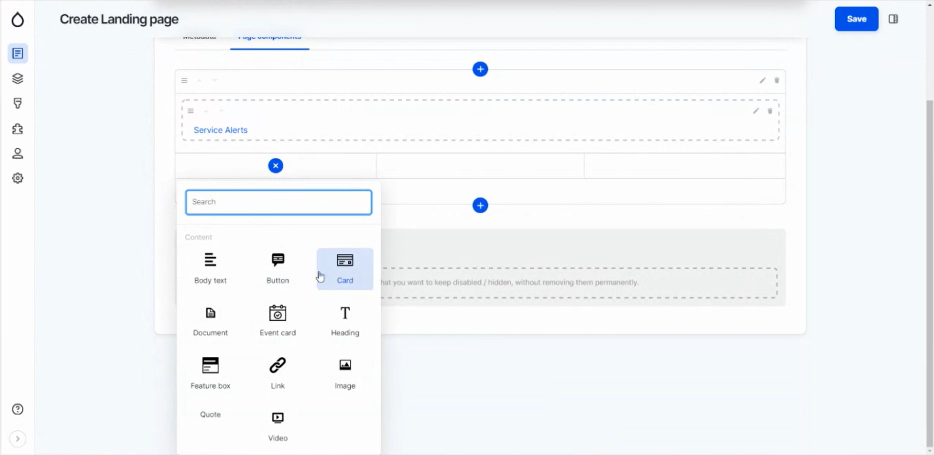

Slide 28
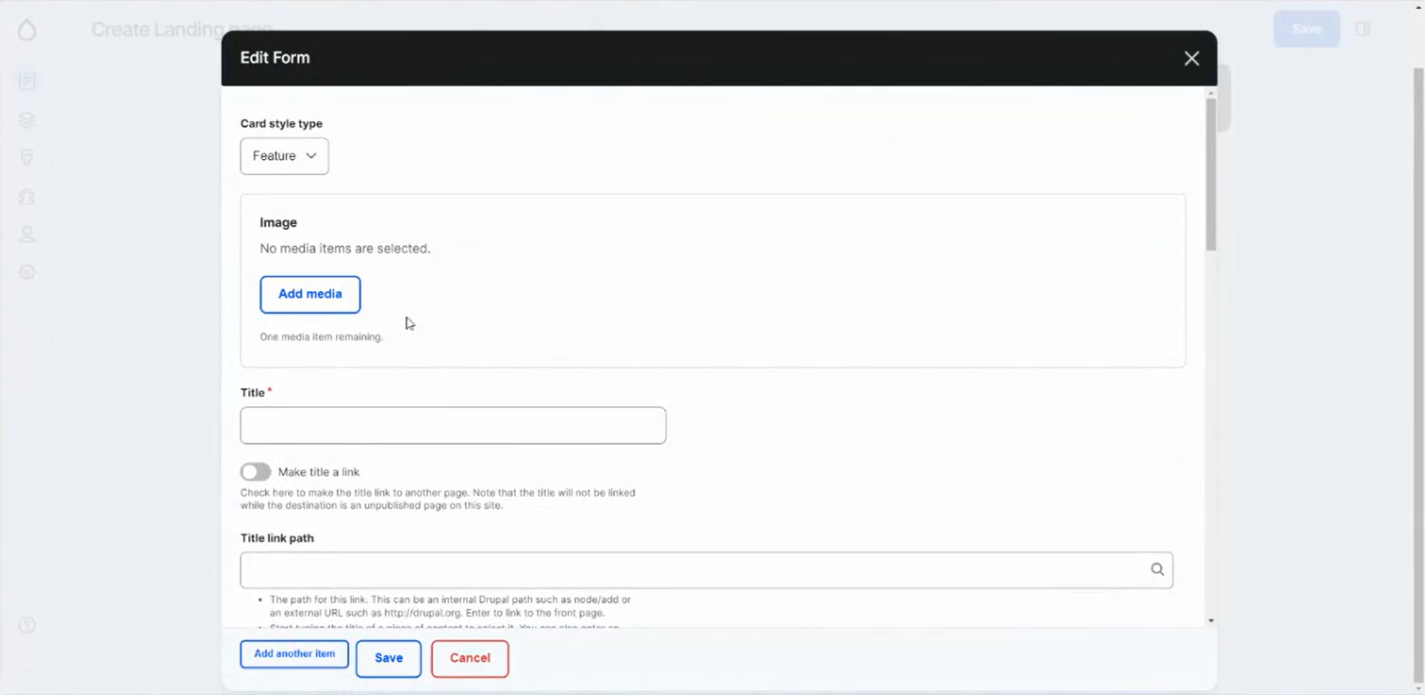

Slide 29
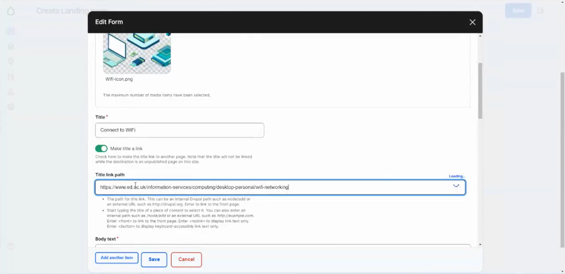

Slide 30
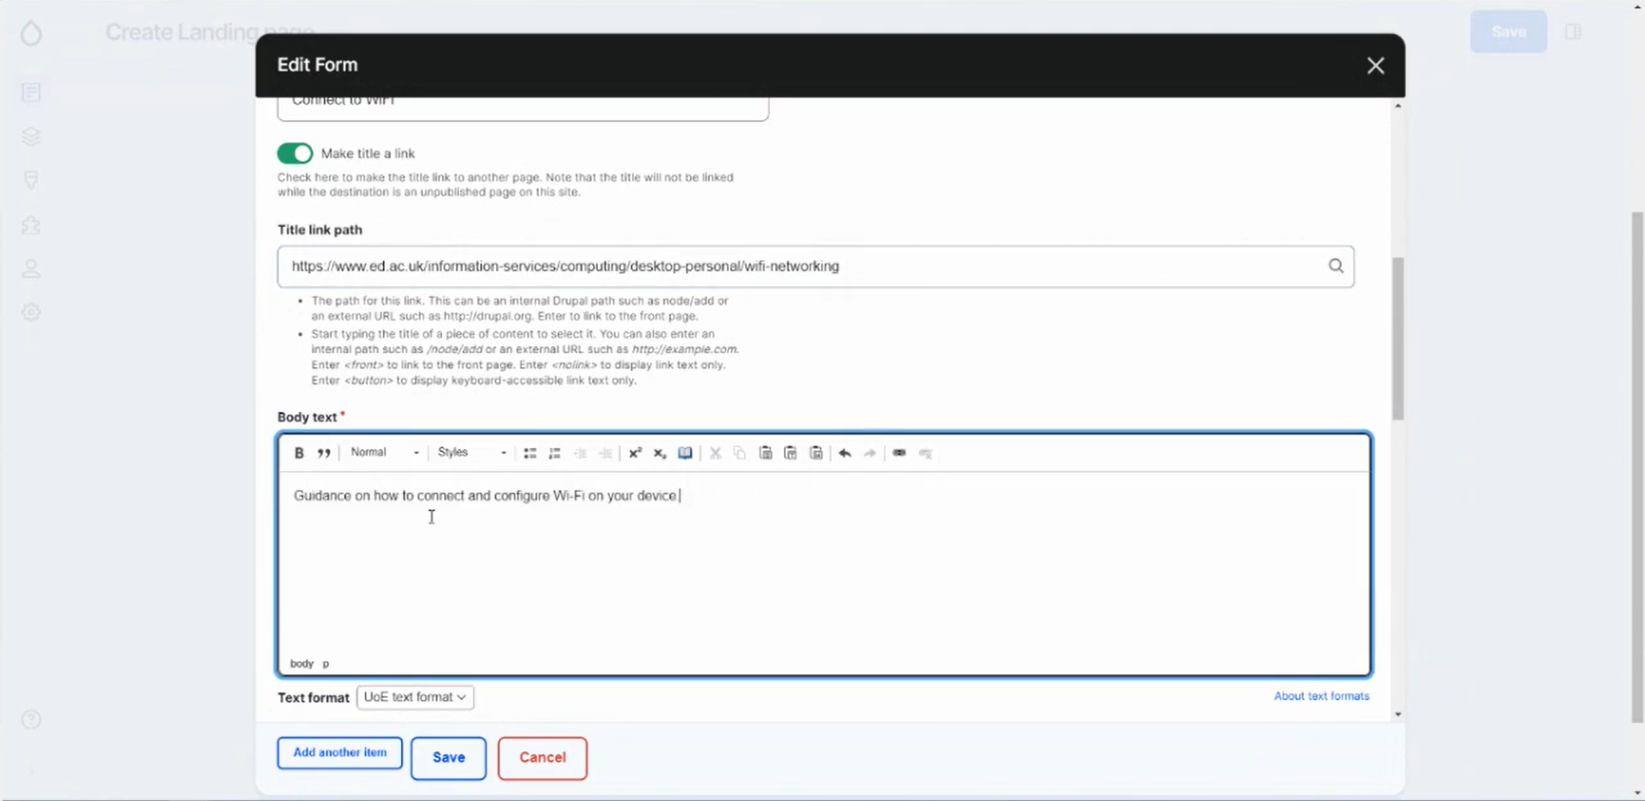

Slide 32
Editoria11y: an example
Editoria11y is an accessibility checker that helps content authors create accessible web content.
It is a valuable tool for helping content authors meet the W3C ATAG regulations.
It is available as a module for Drupal, and is based upon the Sa11y accessibility checker library.
https://editoria11y.princeton.edu

Slide 33
Editoria11y can help content authors meet the W3C ATAG regulations
It checks for a wide range of accessibility issues, including those covered by the W3C ATAG regulations.
It provides feedback on potential accessibility issues, with helpful tips on how to fix them.

Slide 34
Specific examples of how Editoria11y can help authors meet the W3C ATAG regulations:
ATAG 2.1.2: Ensure that all non-text content has a text equivalent. Editoria11y checks for missing or empty alt text for images.
ATAG 2.2.1: Structure content of web pages in a way that is consistent with the W3C HTML5 specification. Editoria11y checks for missing or incorrect headings.

Slide 35
Editoria11y is not an overlay
It does not modify the site viewed by not-logged-in-users in any way.
It is an editor-facing “accessibility assistant” that helps site editors create accessible content.

Slide 36
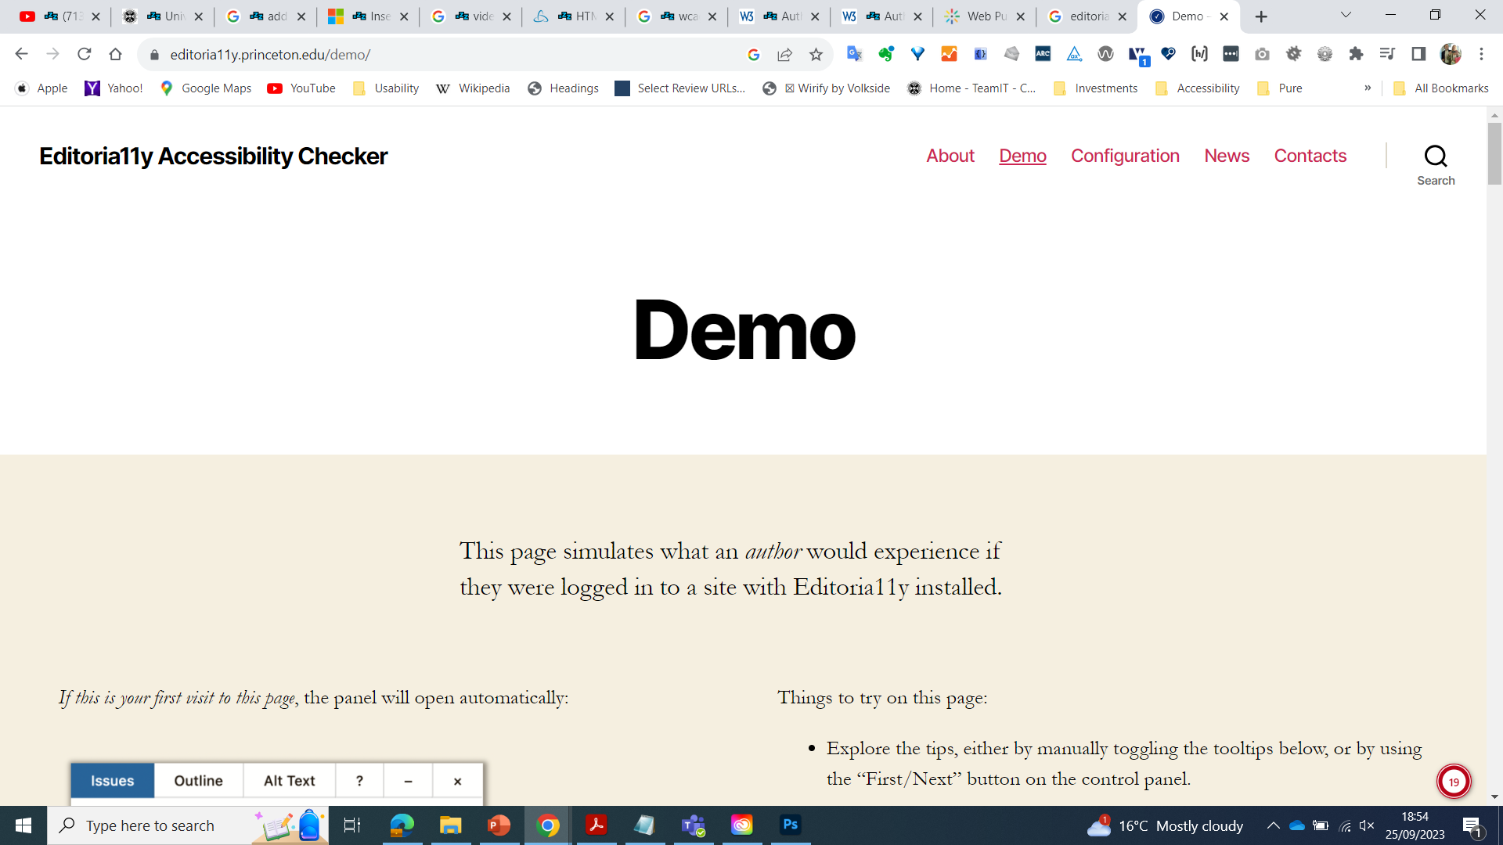

Slide 37
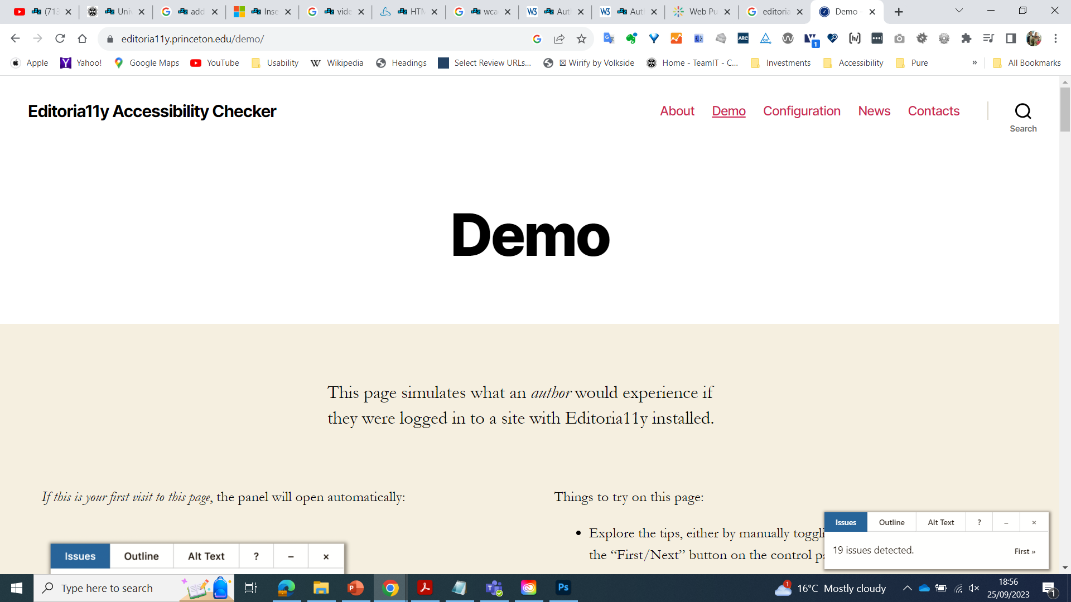

Slide 38
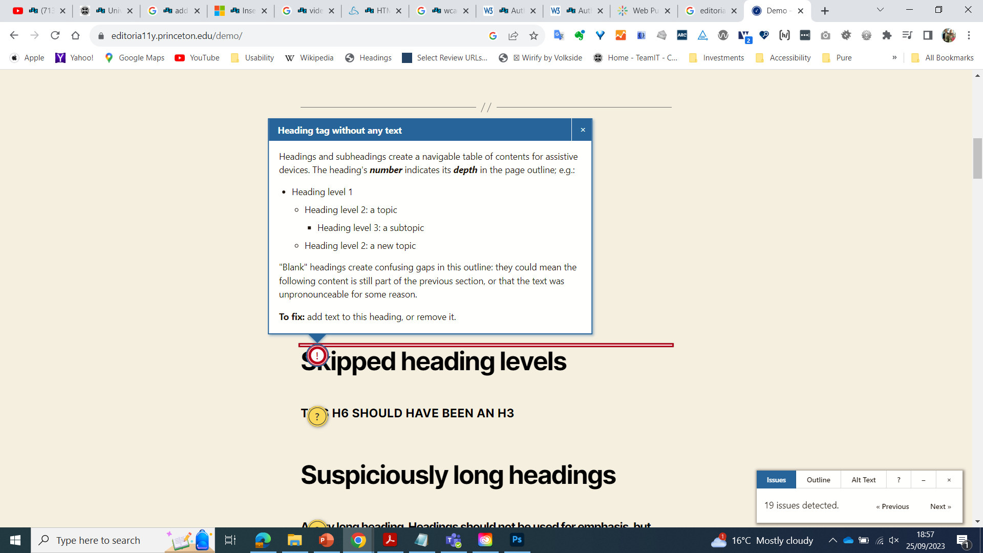

Slide 39
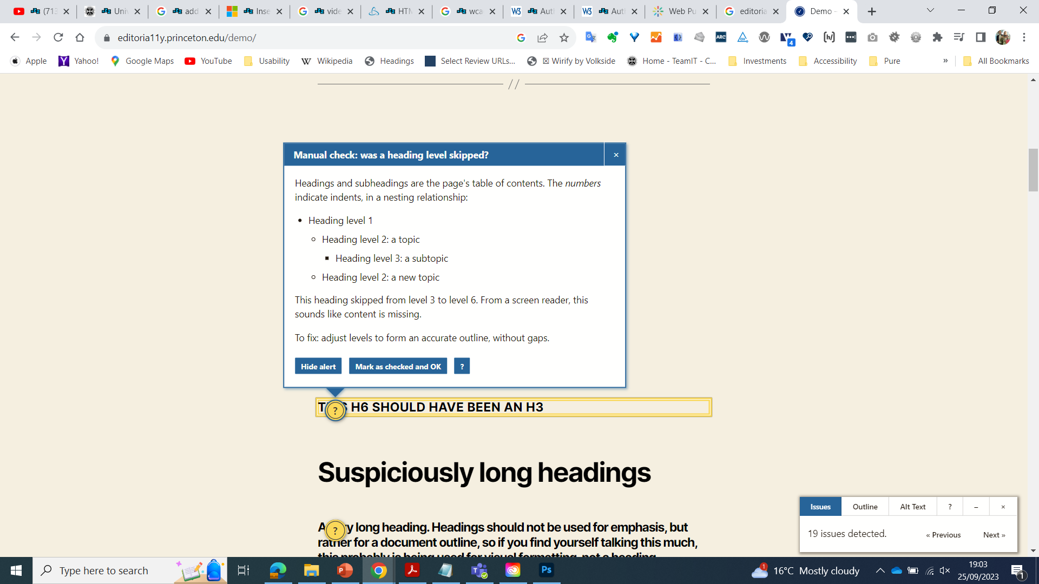

Slide 40
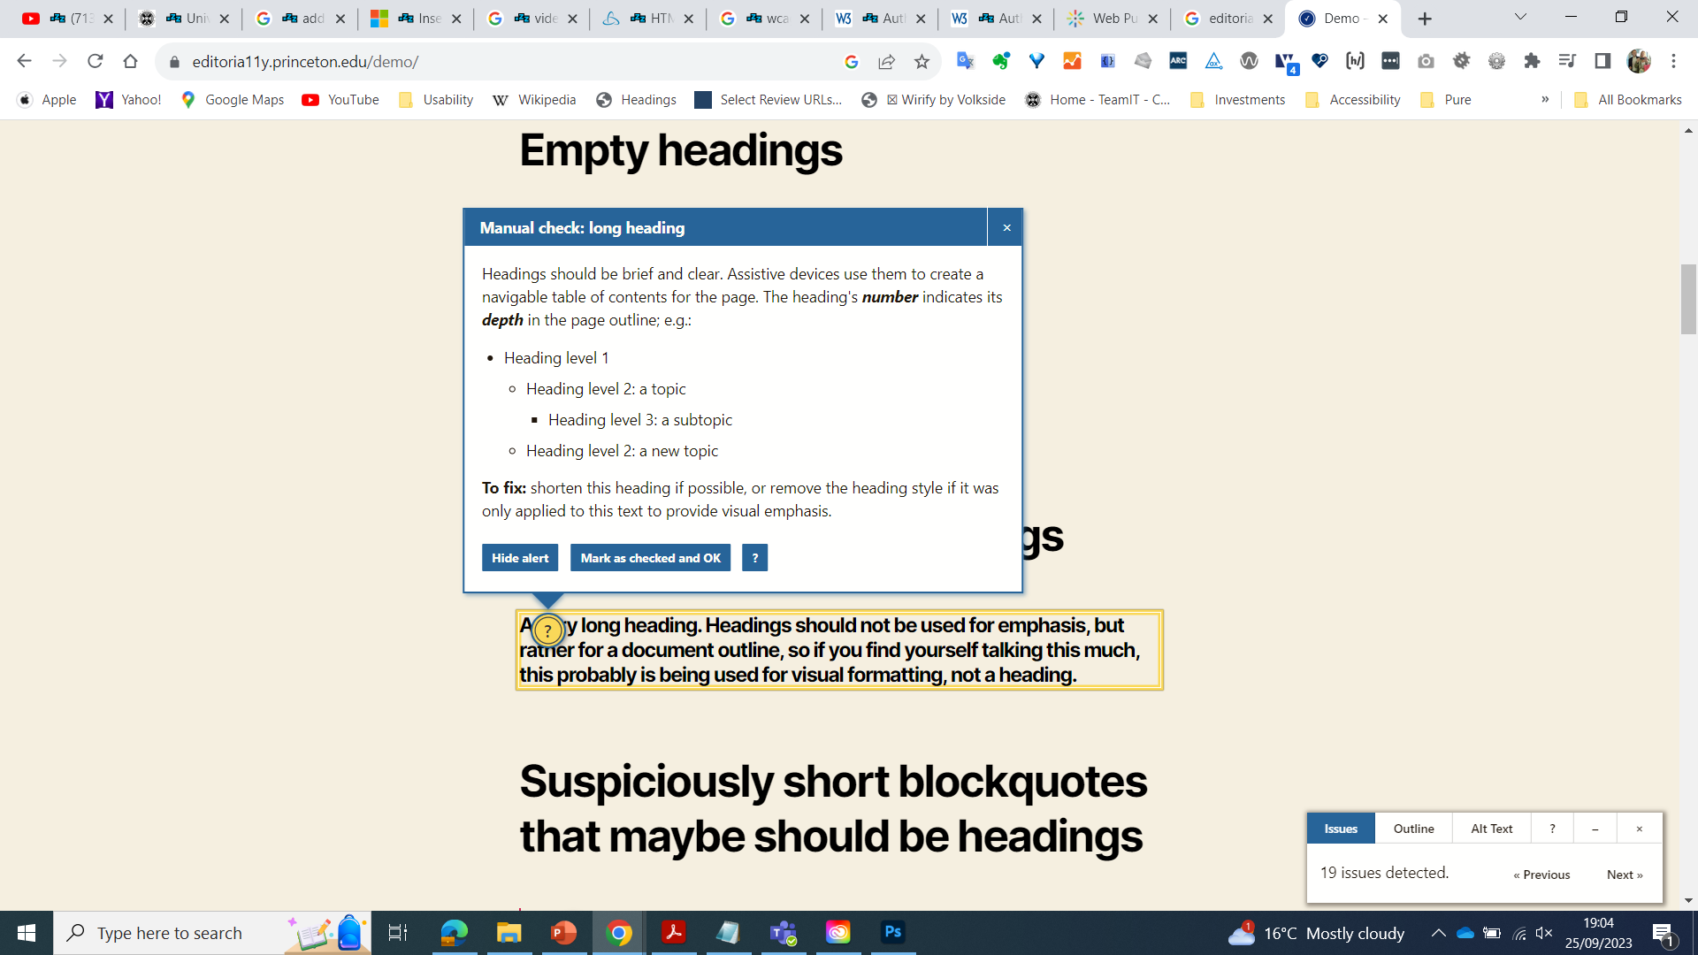

Slide 41
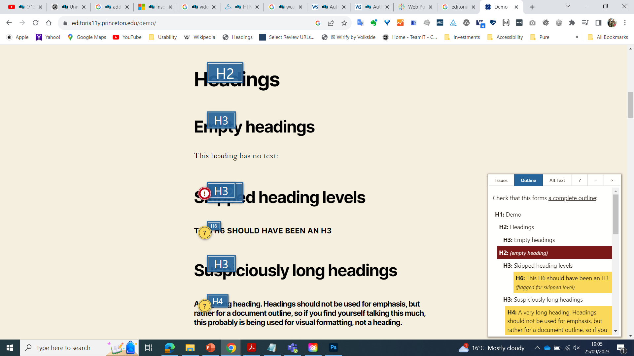

Slide 42
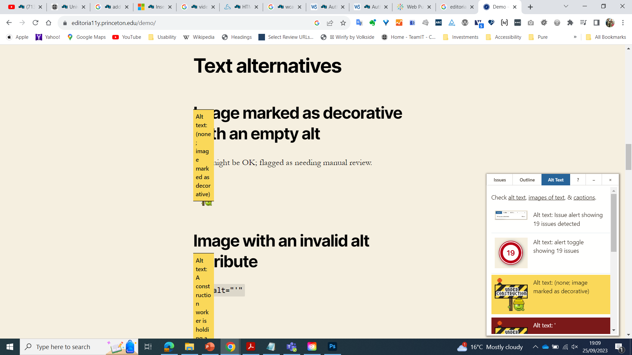

Slide 43
Links between Accessibility and Sustainability
Web accessibility and web sustainability share several overlapping themes and mutually beneficial practices.
This synergy creates a powerful force for positive change in the digital landscape, benefiting both users and the environment.

Slide 44
Links between Accessibility and Sustainability
Over this summer, three student internships have worked on investigating the sustainability challenges faced by the University’s web estate and research potential solutions that we could consider in the future.
The interns were Catalina Rincon, Oisin Doherty and Christopher O’Neill
They have blogged about their recent experiences here: https://blogs.ed.ac.uk/website-communications/category/interns/

Slide 45
Internships - Our Objectives
Investigate how our web estate impacts the environment
Research and identify metrics to measure environmental impact
Use metrics to measure the environmental impact of our web estate
Research & implement sustainable UX Design Practices​
Deliver Recommendations​

Slide 46
Some key points of intersection:
1. User-Centered Design:
Accessibility: Ensures that websites are usable by people with various disabilities, including visual, auditory, physical, speech, cognitive, and neurological disabilities.
Sustainability: Focuses on creating efficient and lean websites that provide a positive user experience, minimizing unnecessary complexity and resource use.

Slide 47
Some key points of intersection:
2. Efficient Code and Content:
Accessibility: Clean and semantic HTML helps assistive technologies interpret content correctly. For example, using appropriate headings, labels, and alt text for images.
Sustainability: Efficient, well-organised code reduces server load and improves page load times, which in turn reduces energy consumption.

Slide 48
Some key points of intersection:
3. Performance Optimization:
Accessibility: Faster websites benefit all users, including those using assistive technologies that can be negatively impacted by slow loading times.
Sustainability: Reducing file sizes, optimising images, and leveraging caching not only improve performance but also reduce the environmental impact of web hosting and data transfer.

Slide 49
Workshop Exercise
Think about your own respective web platform that you use, or are responsible for (probably Drupal!).
What strategies/tools would you consider in implementing an accessibility governance approach on your own web platform? In other words, what measures could you take to better enforce web accessibility compliance on your web platform.
What strategies/tools would you consider in implementing a sustainability governance approach on your own web platform? In other words, what measures could you take to better enforce web sustainability compliance on your web platform.

Slide 50
Pillars of web governance
Security
Privacy
Accessibility
User Experience
Sustainability

Slide 51
Pillars of web governance
Security,Privacy,Accessibility,User Experience,Sustainability
These principles have been adopted into the University Website Publishing Platform
The team are working to ‘bake in’ a number of these principles into the University Website Publishing Platform
A key part of our web strategy and our continuous improvement approach

Slide 52
Pillars of web governance
Scale
Citing the importance of scale of deployment of this platform
Many websites on our web estate/platform
Many users on our web estate/platform
Delivering on a number of these principles by aiming to ‘build in’ these aspects of web governance, as well as offering training, support and continuous auditing / maintenance / improvement.

Slide 53
Drupal Starshot - Pillars of web governance
Security,Privacy,Accessibility,User Experience,Sustainability
These principles have been adopted into the Drupal Core and the Drupal Starshot Initiative.
A number of people in the Drupal community are keen to ‘bake in’ a number of these principles into the Drupal Core and Drupal Starshot Initiaitive.
A key part of our web strategy and our continuous improvement approach

Slide 54
Drupal Starshot - Pillars of web governance
Scale
Citing the importance of scale of deployment of this platform
Many websites on Drupal, many to come on Drupal Starshot.
Many users on Drupal, many to come on Drupal Starshot.
Delivering on a number of these principles by aiming to ‘build in’ aspects of these pillars of web governance at scale.
Built on the principles laid out in the Open Web Manifesto: https://www.drupal.org/association/open-web-manifesto

Slide 55
Strands - Pillars of web governance
Security,Privacy,Accessibility,User Experience,Sustainability
Pulling these strands together
The way into governance - pulling more people in together
Opening minds – people who only do Security, see the related strands relate to their work – security needs to be accessible, for example.
You need think about all these things, less easy to dismiss related pillars.
Embed into governance process. Again laid out in the Open Web Manifesto: https://www.drupal.org/association/open-web-manifesto

Slide 56
Accessibility at every step

Slide 57

@hdv@front-end.social / @hdv
Planning/ Strategy
Interaction Design
Visual Design
Development
Quality Assurance
Launch

Slide 58

@hdv@front-end.social / @hdv
Planning/ Strategy
Interaction Design
Visual Design
Development
Quality Assurance
Launch
Choose an authoring tool that supports accessibility

Slide 59

@hdv@front-end.social / @hdv
Planning/ Strategy
Interaction Design
Visual Design
Development
Quality Assurance
Launch
Document all accessibility aspects of the UI
Test authoring with users with disabilities

Slide 60

@hdv@front-end.social / @hdv
Planning/ Strategy
Interaction Design
Visual Design
Development
Quality Assurance
Launch
Set constraints for customising colour combinations (for contrast)
Provide accessible examples, like large enough touch targets

Slide 61

@hdv@front-end.social / @hdv
Planning/ Strategy
Interaction Design
Visual Design
Development
Quality Assurance
Launch
Pick themes with accessibility support
Pick plugins with accessibility support

Slide 62

@hdv@front-end.social / @hdv
Planning/ Strategy
Interaction Design
Visual Design
Development
Quality Assurance
Launch
Embed automated accessibility tests
in the authoring process

Slide 63

@hdv@front-end.social / @hdv
Planning/ Strategy
Interaction Design
Visual Design
Development
Quality Assurance
Launch

Slide 64
Conclusion
Accessibility can't be automated and not everything has an easy fix, but there are remedies we could build into design systems, browsers and CMSs
Use a CMS that can be set up to work as an accessibility assistant for content editors
The upcoming University Website Publishing Platform is a promising example of this. This is also an exciting potential opportunity for Drupal Starshot.
Accessibility (and sustainability) is easier when you do it earlier, and consider it throughout the lifecycle of the website.

Slide 65
Thank you!
LinkedIn Profile:
https://www.linkedin.com/in/johnwalterlockhart/

Slide 66

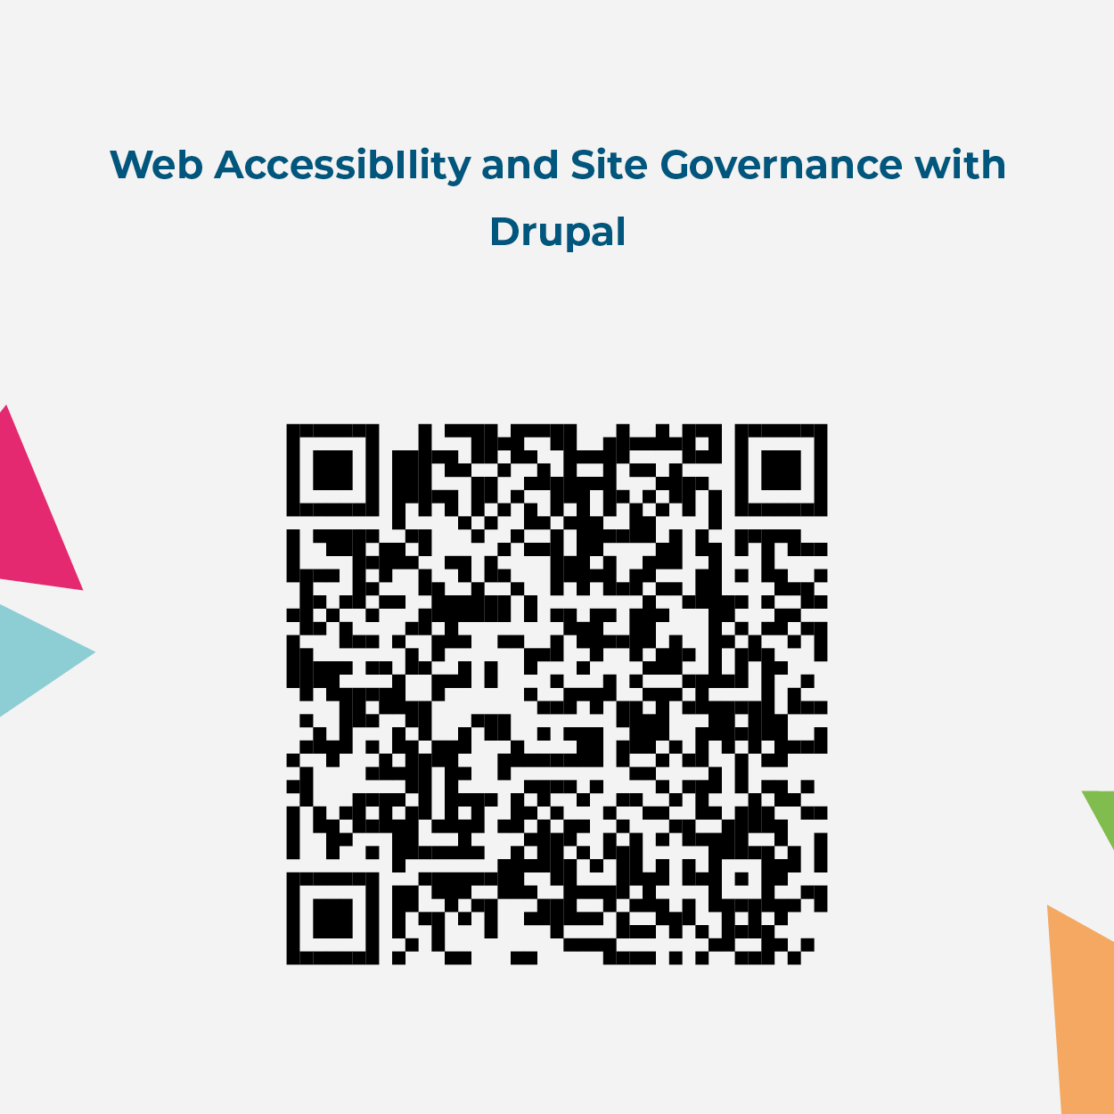

What did you think?
Please fill out the Individual session survey
(in the Mobile App using QR code)
QR Will be provided to the Speakers prior to the conference

Slide 67
Join us for contribution opportunities!
Mentored
Contribution
First Time
Contributor Workshop
General
Contribution
27 September:
09:00 – 18:00
Room 111
24 September: 16:30 - 17:15
Room BoF 4 (121)
25 September: 11:30 - 12:15
Room BoF 4 (121)
27 September: 09:00 - 12:30
Room 111
24-26 September: 09:00 - 18:00
Area 1
27 September: 09 - 18:00
Room 112
#DrupalContributions

